Slide 1
The Effect of Accidents on Air Travel Executive Summary
Bellevue University
DSC640-T302 Data Presentation & Visualizations
Michelle Helfman
January 19, 2024

Slide 2
Airline Accidents - The Lead Off Story
Airline accidents are big news; the story dominates the 24/7 news cycle for days. Postings on Facebook and X (formerly known as Twitter) spread misinformation and create distrust. The ensuing investigations keep the story in everyone’s mind, not allowing air carriers to move on. Major motor vehicle crashes are so commonplace that unless a highway is closed for an extended period, the local news station doesn’t mention it, and drivers just work around the accident.
Does all the publicity have an effect on air travel?
Compare airline and motor vehicle accident statistics.
Explore airline accidents and fatalities
The effect of negative publicity on market share, number of passengers, customer satisfaction, and revenue for major US-based airlines.
Was Southwest Airlines affected by recent accidents?

Slide 3
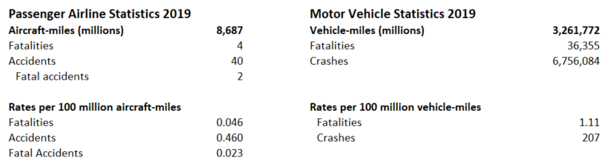
Airline vs Motor Vehicle Statistics 2019
Bureau of Transportation Statistics
Miles traveled by US-based airlines is less than 1% of motor vehicle miles traveled.
Airline accidents and fatalities are effectively 0 compared to motor vehicle crashes.
Major airplane crashes can have hundreds of fatalities, while hundreds of motor vehicles have less than 2 fatalities per crash.

Slide 4
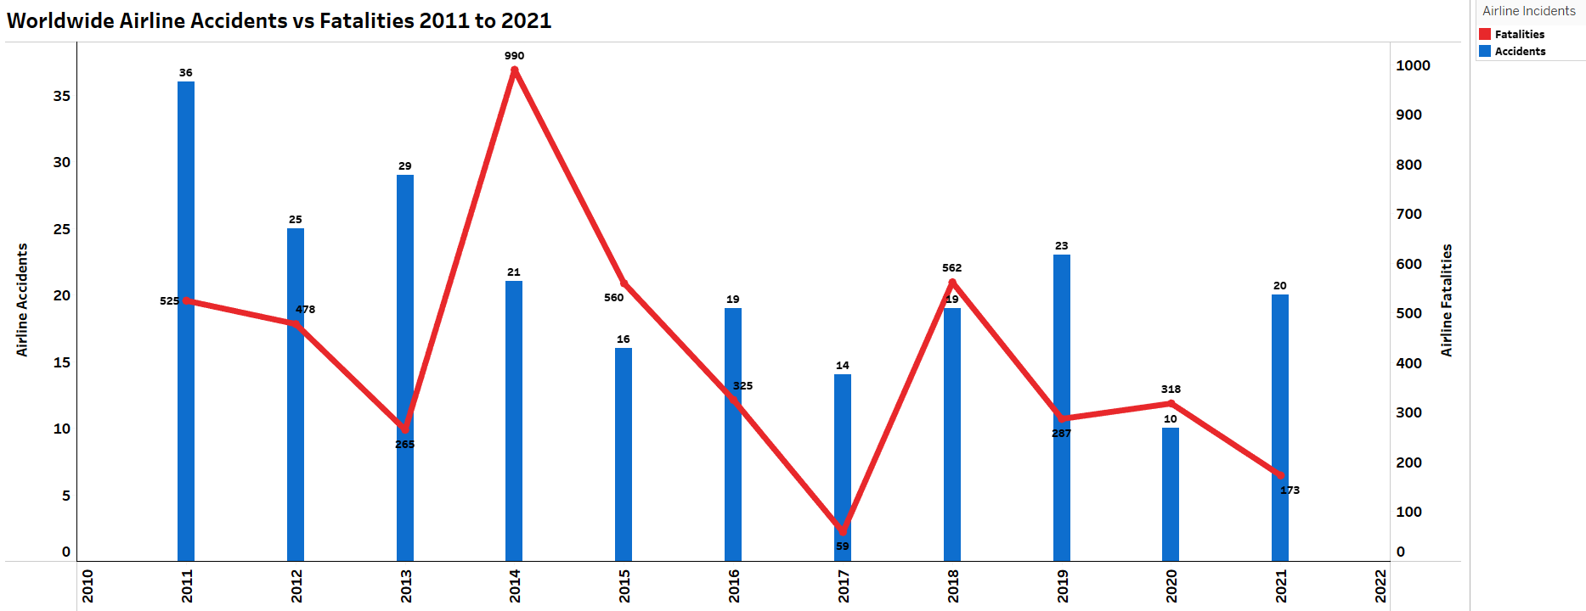
Air Travel – Worldwide Statistics
Google Docs
There have always been a small number of fatal accidents, but even 1 crash can have hundreds of fatalities.
Two crashes in 2014 accounted for 537 deaths (56%)

Slide 5
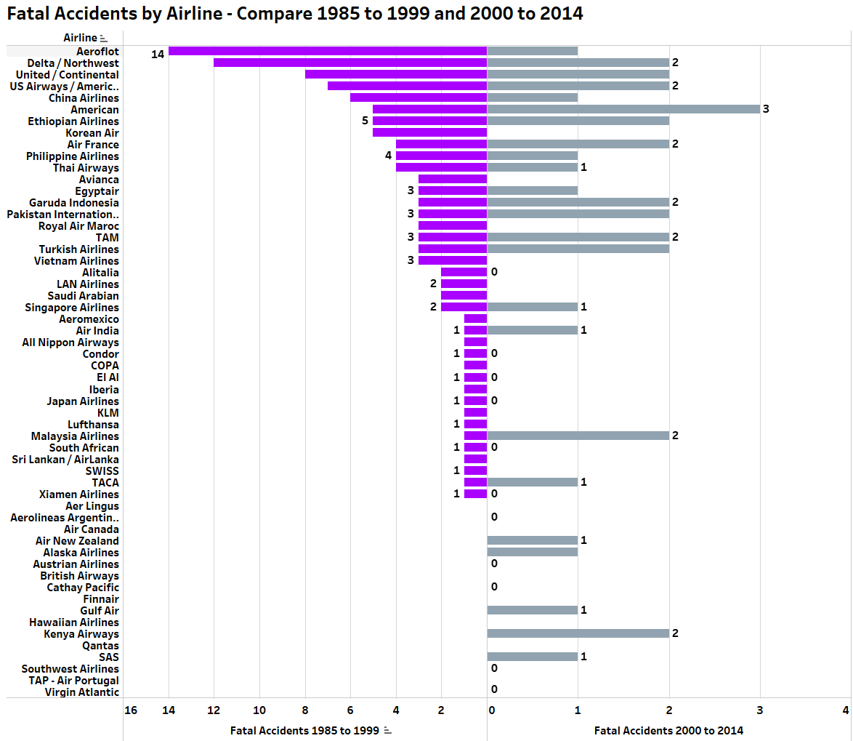
Decrease in Fatal Accidents In Recent Years
Advances in technology in air traffic control and the cockpit have decreased fatal accidents significantly
Better aircraft design and maintenance.
More comprehensive safety procedures
Southwest Airlines has had 0 fatal accidents.
data.world

Slide 6
Have Recent Accidents Affected Air Travel?

Slide 7
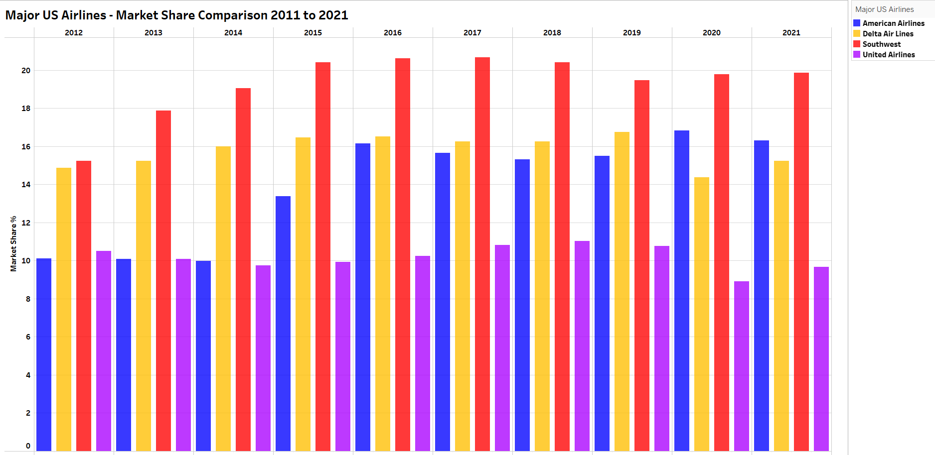
Market Share
Statista
Market share is not susceptible to outside forces, including accidents and fatalities. Even during the pandemic, market share between the major US-based airlines remained stable.

Slide 8
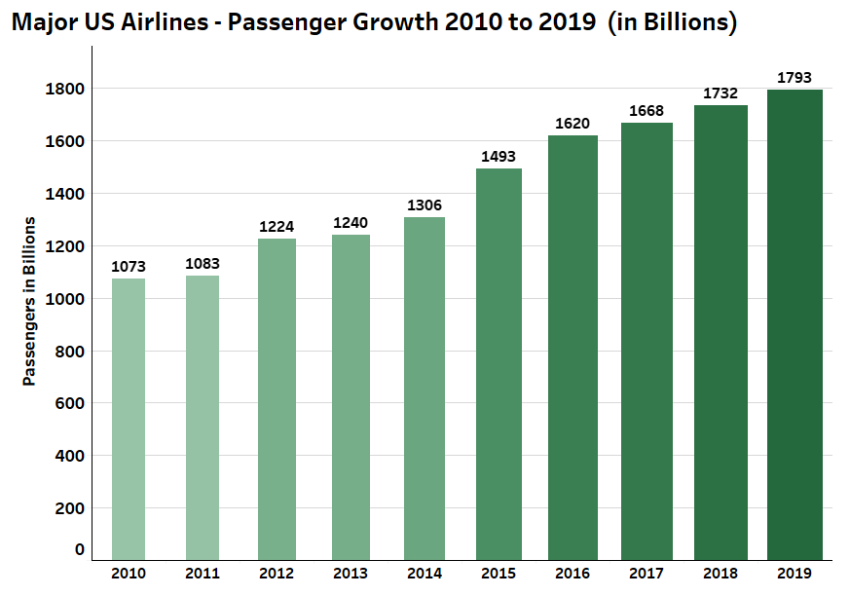
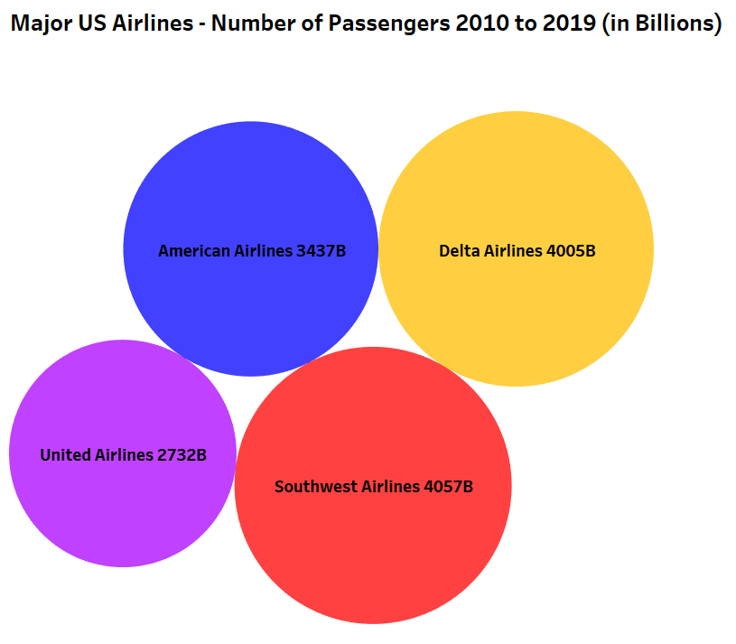
Passenger Growth
Massachusetts Institute of Technology
Massachusetts Institute of Technology
Low airfares and higher standards of living contribute to the steady increase in airline passengers per year
Southwest Airlines has the largest number of passengers during this 10-year period.
Note – Pre-Pandemic information only

Slide 9
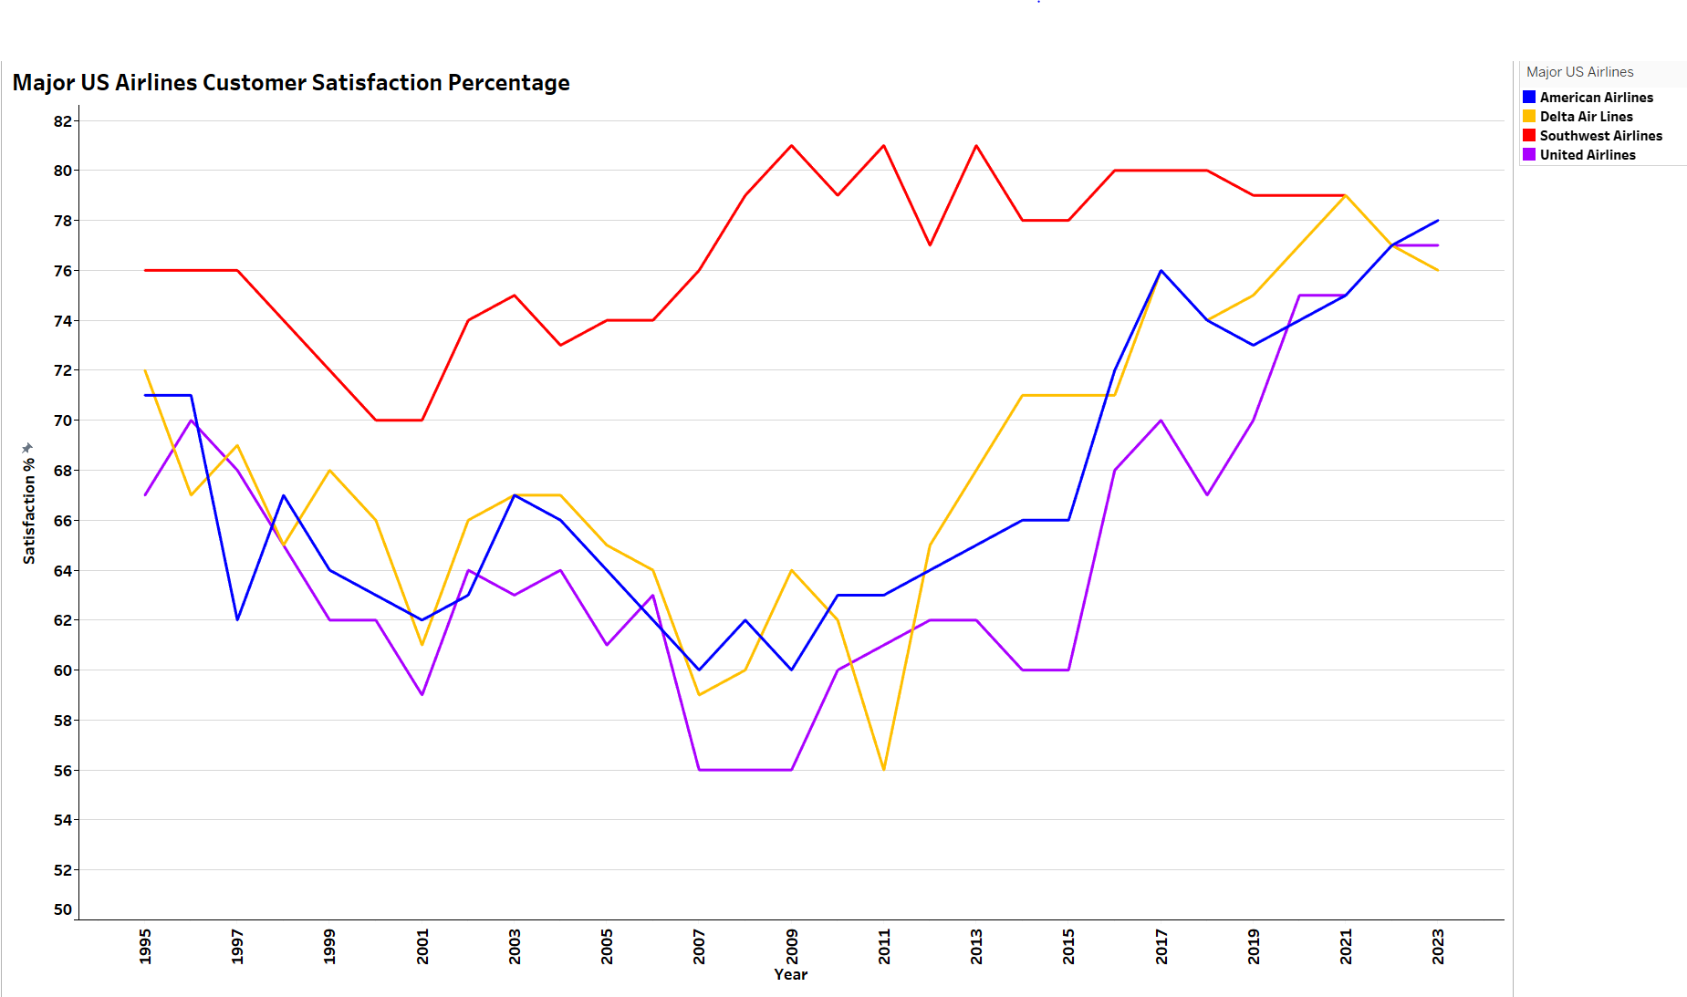
Customer Satisfaction
Statista
All Major US-based airlines have maintained above 70% customer satisfaction rates since 2016
Southwest Airlines consistently has been at 70% or above since 1995, ranking #1

Slide 10
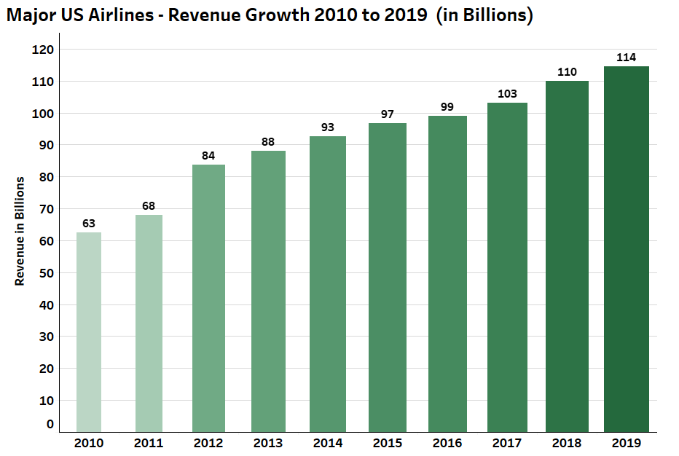
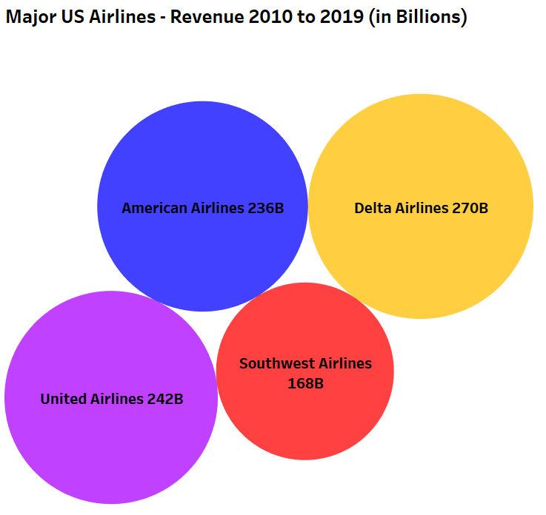
Revenue Growth
Massachusetts Institute of Technology
Massachusetts Institute of Technology
An increase in the number of passengers and low fuel costs contribute to the steady increase in airline revenue per year.
The three airlines with both domestic and international flights had the most revenue, with over $200 billion. Southwest Airlines is low-cost and primarily offers domestic flights.
Note – Pre-Pandemic information only

Slide 11
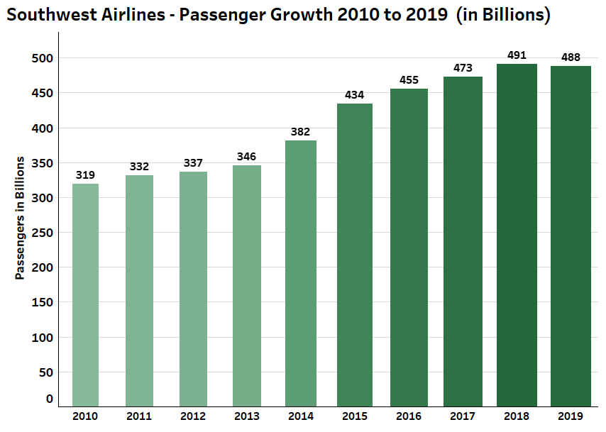
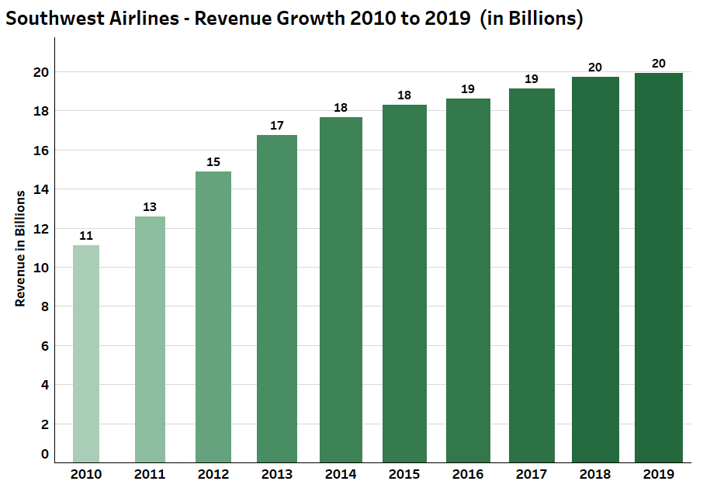
Southwest Airlines
Massachusetts Institute of Technology
Massachusetts Institute of Technology
The number of passengers and revenue have had steady growth since 2010, but have begun to level off in the past two years.
Southwest Airlines has consistently had the highest domestic market share for at least 10 years.
Customer satisfaction has remained the highest of the major US-based airlines, with only a small downtick due to the December computer outages in 2022.
Note – Pre-Pandemic information only

Slide 12
Conclusion
With technological advancements in the air and on the ground, flying is the safest way to travel.
Accidents and fatalities continue to decrease as equipment and robust safety procedures are updated.
Negative publicity does not have an impact on the number of passengers or revenue growth.
Customer satisfaction remains high for all the major US-based airlines.

